Slide 1
Phrase Detection
Prudhvi Raj Dachapally

Slide 2
RAKE method of finding candidate key-phrases
Starch is an odorless tasteless white substance occurring widely in plant tissue and obtained chiefly from cereals and potatoes. It is a polysaccharide that functions as a carbohydrate store and is an important constituent of the human diet.

Slide 3
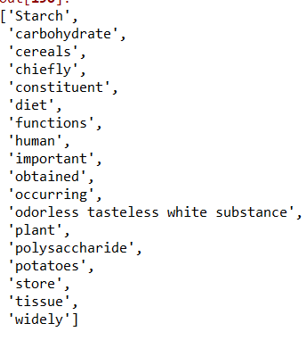
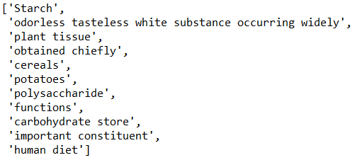
Phrase Filtering
Candidate Phrases
Collected Phrases

Slide 4
Another Example
Chlorophyll is a green pigment , present in all green plants and in cyanobacteria , responsible for the absorption of light to provide energy for photosynthesis . Its molecule contains a magnesium atom held in a porphyrin ring.

Slide 5
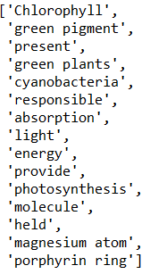
Filtered Phrases

Slide 6
Methods
Chaining
Idea: “What’s the next important word that takes into account the previous word?”
In the Starch example, the chain is as follows:
Good Initialization
Starch -> polysaccharide -> carbohydrate -> diet -> cereal -> potato -> plant
Bad Initialization
Widely -> chiefly -> constituent -> human -> tissue -> polysaccharide -> carbohydrate

Slide 7
Methods
Clustering
Idea – “What will be the top-k words that will represent/describe the current word?”
In the Starch example, the cluster is as follows
Good Initialization
Starch -> Polysaccharide, carbohydrate, cereal, tissue, odorless tasteless white substance, diet
Bad Initialization
Occurring -> important, human, function, tissue, store, widely

Slide 8
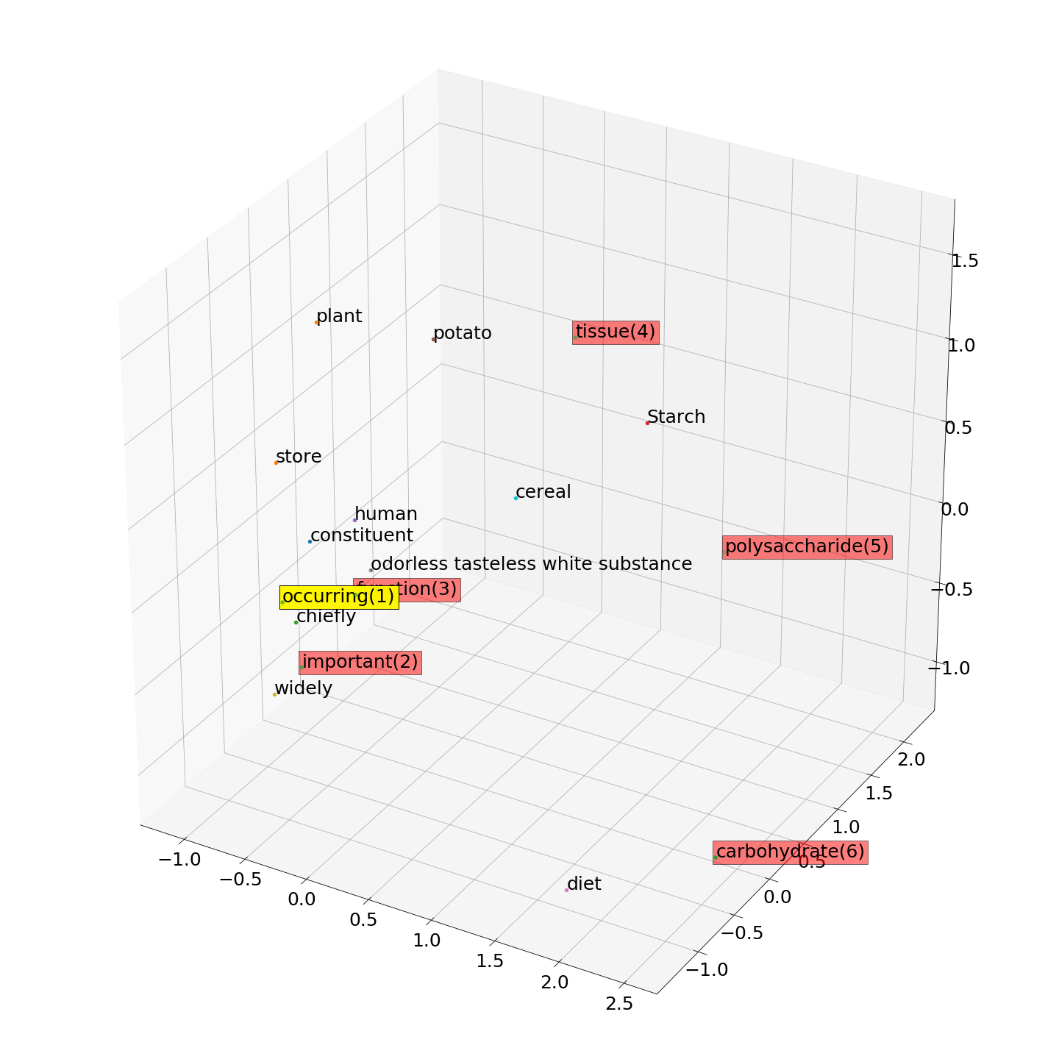
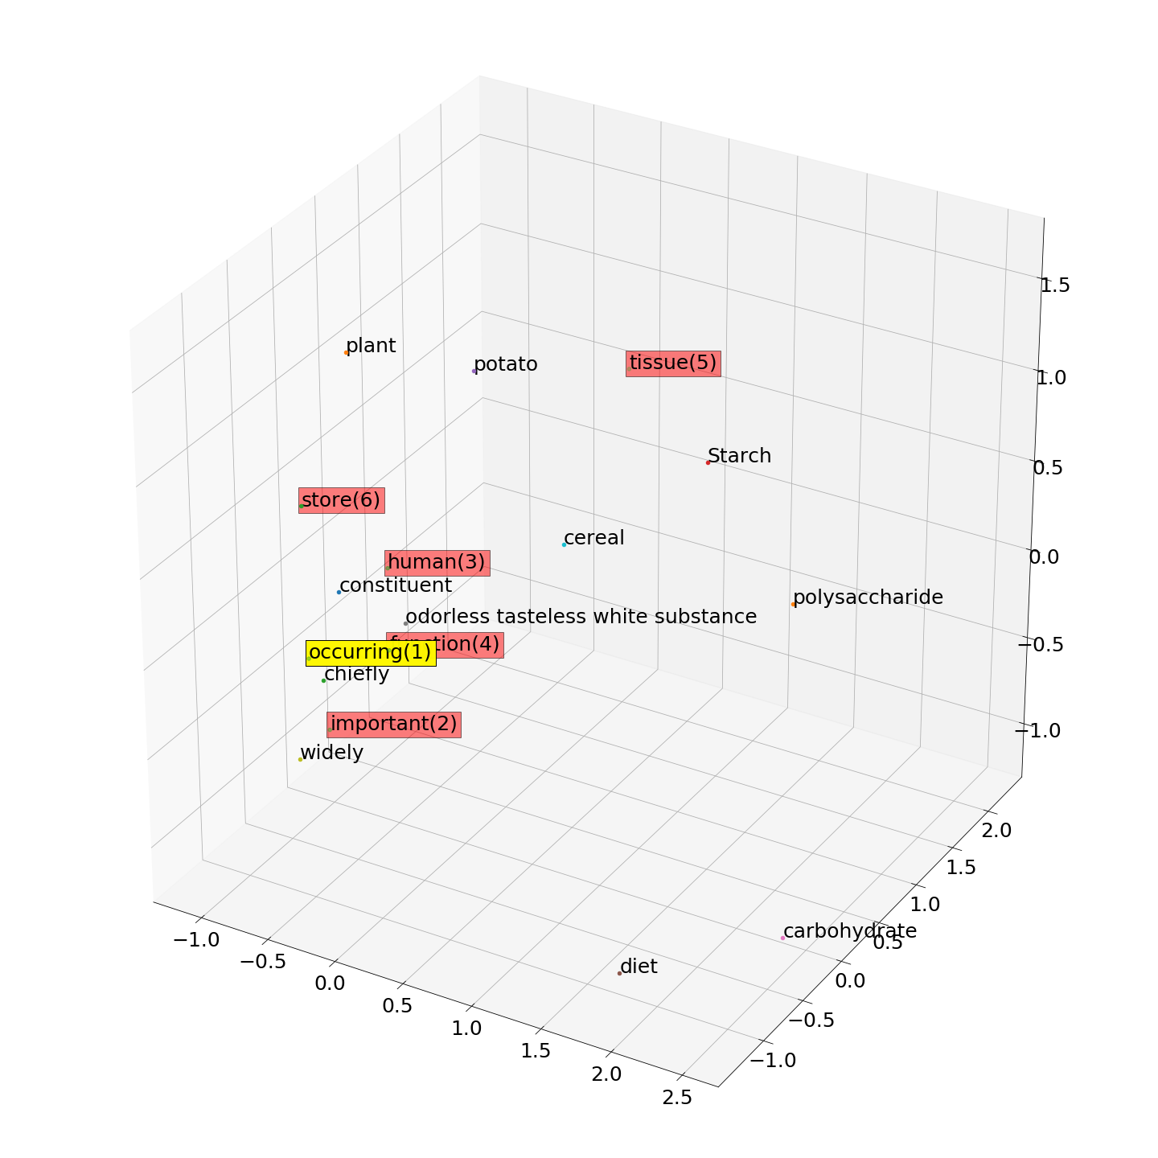
Clustering
Chaining

Slide 9
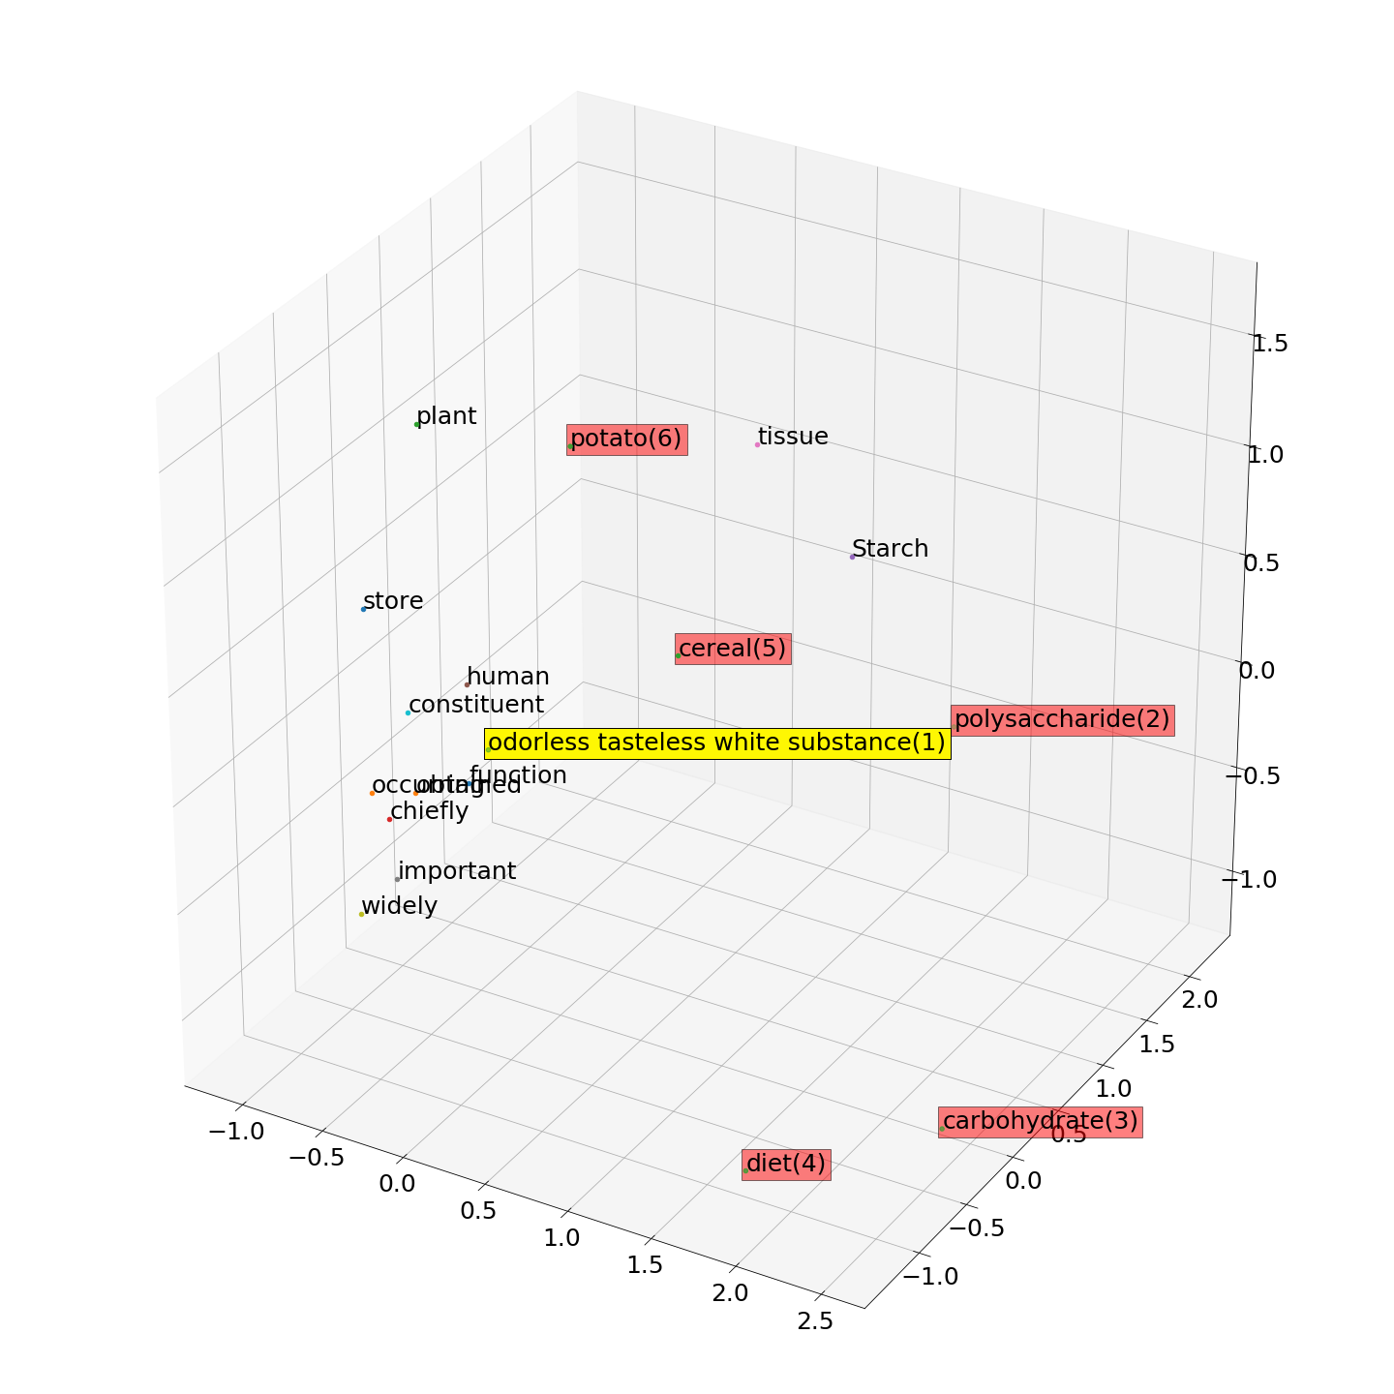
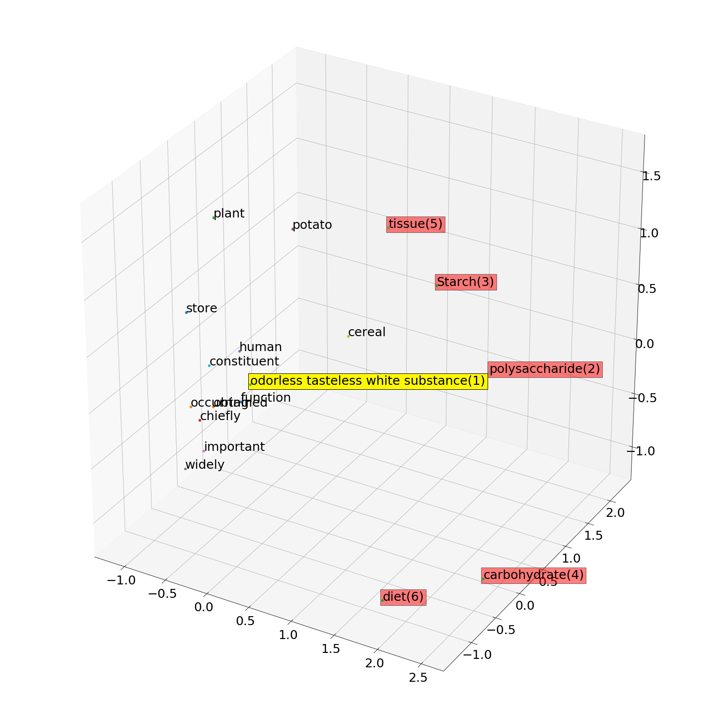
Clustering
Chaining

Slide 10
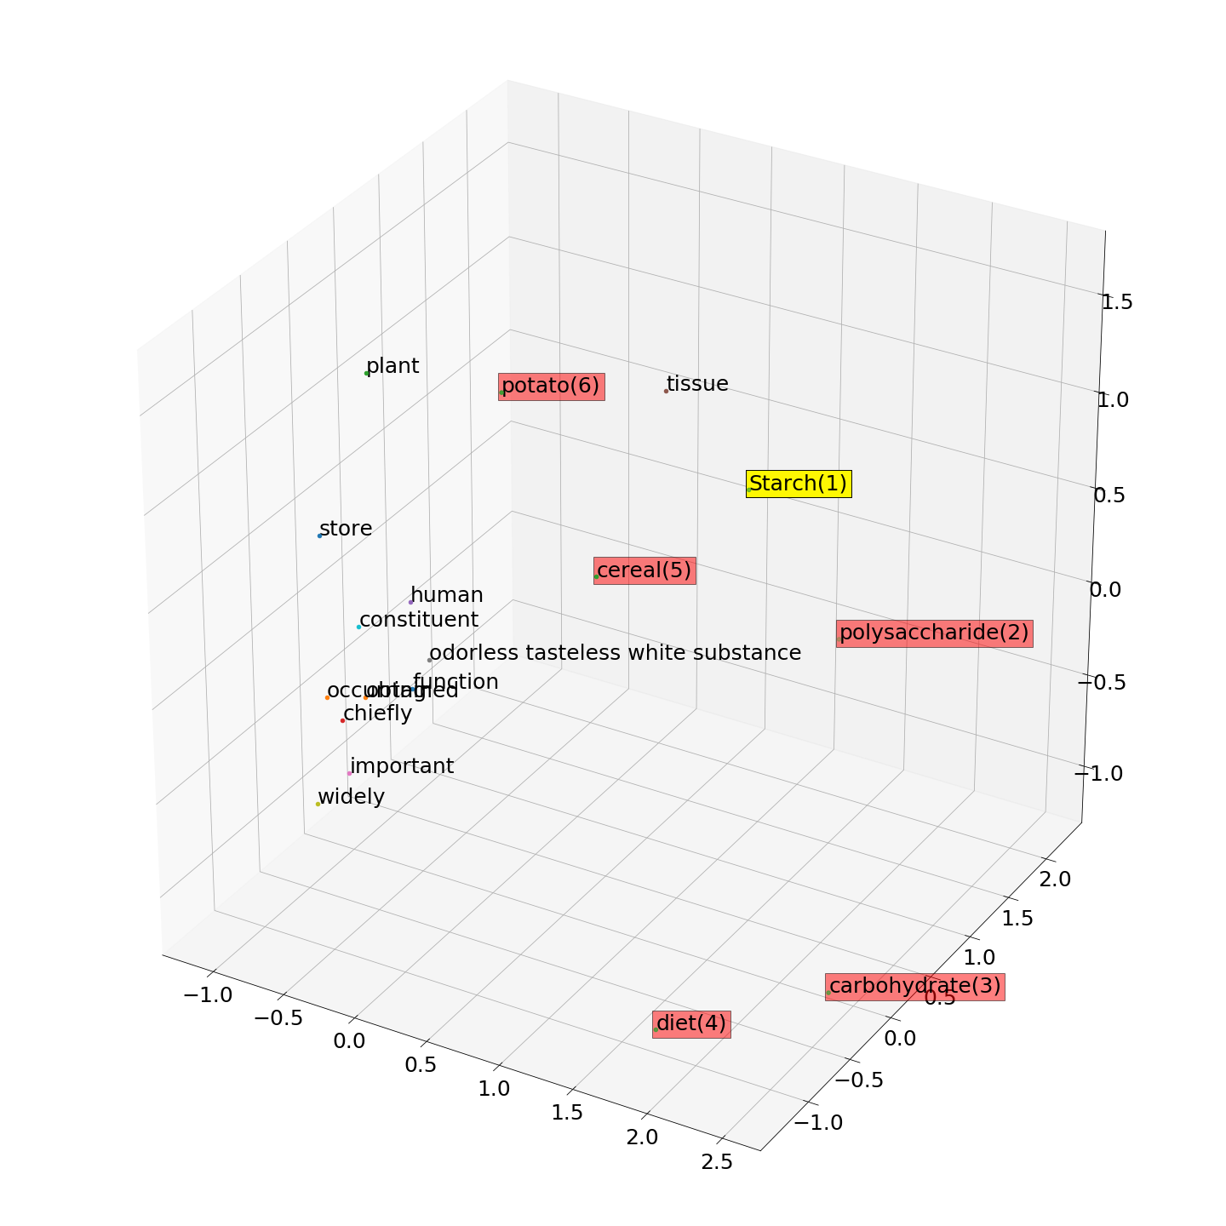
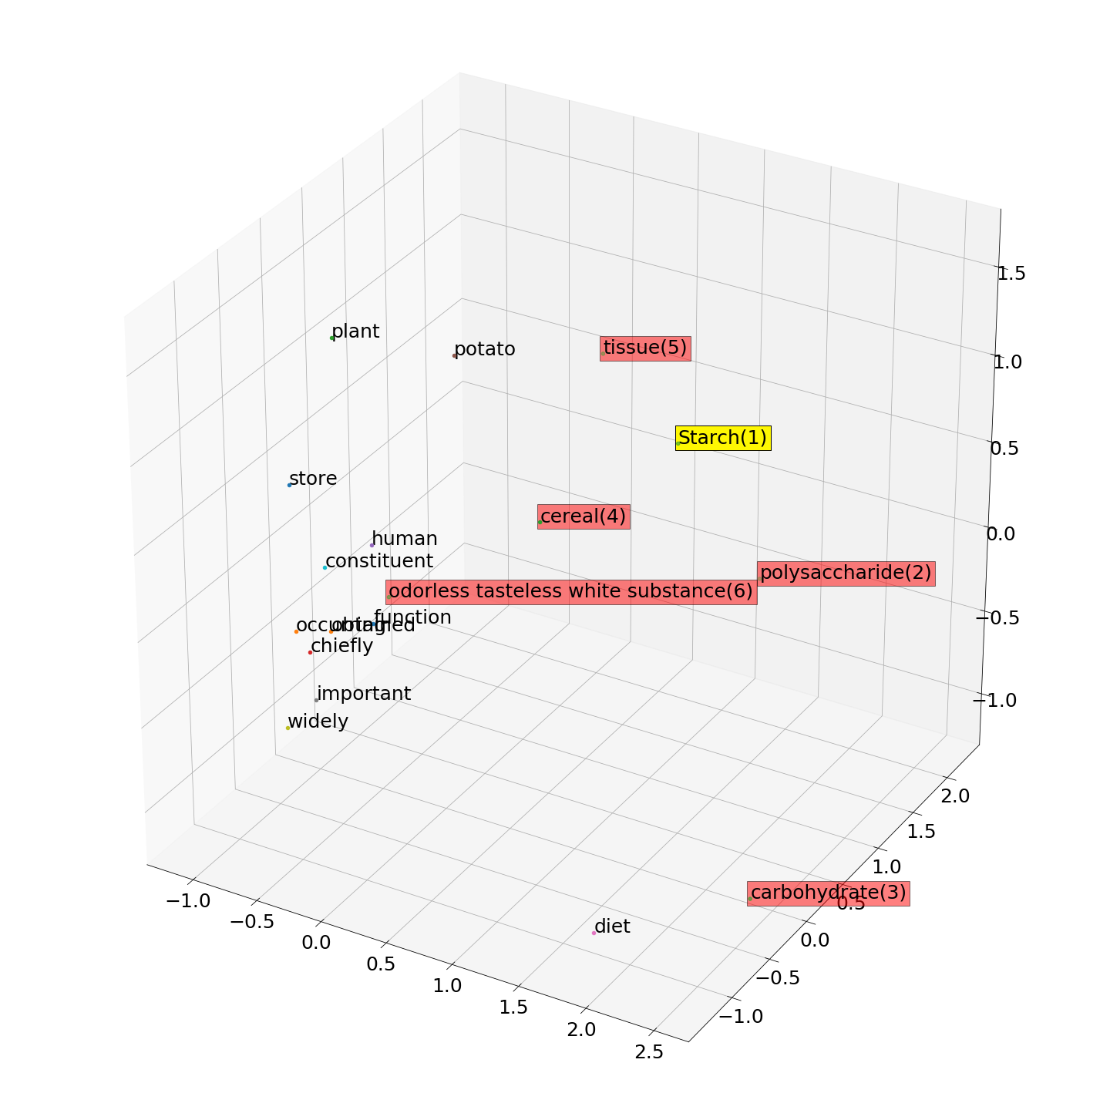
Chaining
Clustering

Slide 11
Ionic Bonding Score = 5 – 1 + (0.5 x 2)/7 = 0.714
Ground Truth
Chaining
Ionic bonding is the complete transfer of valence electrons between atoms. It is a type of chemical bond that generates two oppositely charged ions. In ionic bonds, the metal loses electrons to become a positively charged cation, whereas the nonmetal accepts those electrons to become a negatively charged anion.
Ionic bonding is the complete transfer of valence electron(2) between atoms. It is a type of chemical bond(7) that generates two oppositely charged ions(3). In ionic bonds(6), the metal loses electrons(1) to become a positively charged cation(5), whereas the nonmetal accepts those electrons to become a negatively charged anion(4).

Slide 12
Ionic Bonding GT – 6: Correct – 4, Half/Half – 3, Miss – 1 Score = 4 – 1 + (0.5 x 3)/7 = 0.6428
Ground Truth
Clustering
Ionic bonding is the complete transfer of valence electrons between atoms. It is a type of chemical bond that generates two oppositely charged ions. In ionic bonds, the metal loses electrons to become a positively charged cation, whereas the nonmetal accepts those electrons to become a negatively charged anion.
Ionic bonding is the complete transfer of valence electrons(3) between atoms(6). It is a type of chemical bond that generates two oppositely charged ions(1). In ionic bonds(7), the metal loses electrons(4) to become a positively charged cation(5), whereas the nonmetal accepts those electrons to become a negatively charged anion(2).

Slide 13
Ionic Bonding Score = 5 – 1 + (0.5 x 2)/7 = 0.714
Ground Truth
Clustering with Chaining Evaluation
Ionic bonding is the complete transfer of valence electrons between atoms. It is a type of chemical bond that generates two oppositely charged ions. In ionic bonds, the metal loses electrons to become a positively charged cation, whereas the nonmetal accepts those electrons to become a negatively charged anion.
Ionic bonding is the complete transfer of valence electrons(4) between atoms. It is a type of chemical bond(7) that generates two oppositely charged ions(3). In ionic bonds(6), the metal loses electrons(5) to become a positively charged cation(1), whereas the nonmetal accepts those electrons to become a negatively charged anion(2).

Slide 14
Ionic Bonding (With Initial word) Score = 6 – 0 + (0.5 x 1) = 6.5/7 = 0.9285
Ground Truth
Chaining
Ionic bonding is the complete transfer of valence electrons between atoms. It is a type of chemical bond that generates two oppositely charged ions. In ionic bonds, the metal loses electrons to become a positively charged cation, whereas the nonmetal accepts those electrons to become a negatively charged anion.
Ionic bonding(1) is the complete transfer of valence electron(6) between atoms. It is a type of chemical bond(3) that generates two oppositely charged ions(4). In ionic bonds(2), the metal loses electrons to become a positively charged cation(7), whereas the nonmetal accepts those electrons to become a negatively charged anion(5).

Slide 15
Ionic Bonding (With Initial word) Score = 6 – 0 + (0.5 x 1) = 6.5/7 = 0.9285
Ground Truth
Clustering
Ionic bonding is the complete transfer of valence electrons between atoms. It is a type of chemical bond that generates two oppositely charged ions. In ionic bonds, the metal loses electrons to become a positively charged cation, whereas the nonmetal accepts those electrons to become a negatively charged anion.
Ionic bonding(1) is the complete transfer of valence electrons(7) between atoms. It is a type of chemical bond(3) that generates two oppositely charged ions(4). In ionic bonds(2), the metal loses electrons to become a positively charged cation(6), whereas the nonmetal accepts those electrons to become a negatively charged anion(5).

Slide 16
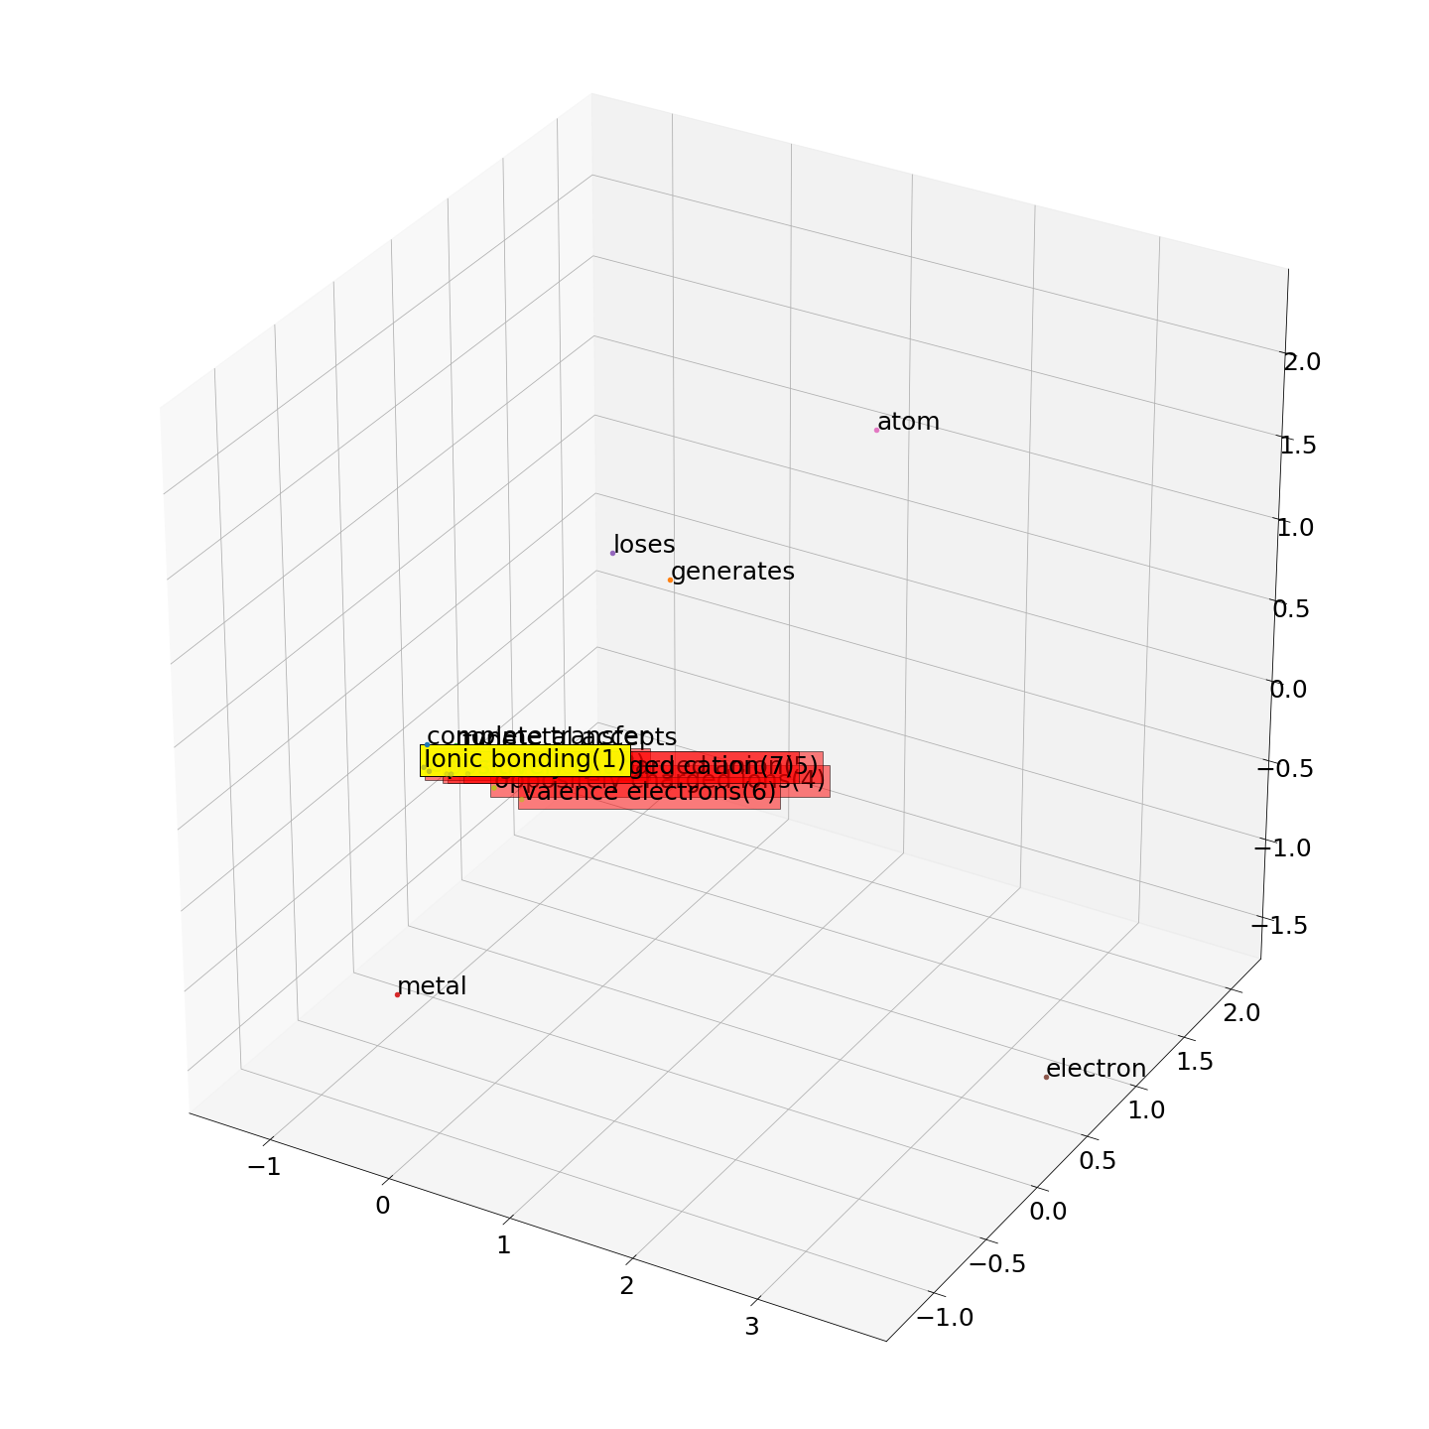

Ionic Bonding
Chaining
Clustering

Slide 17
Labeled Data
Currently 12 examples taken from biology and chemistry domains.
Each sample is labeled with an adequate number of keywords and key-phrases
Examples:
Ionic Bonding
Benzene
Starch
Chlorofluorocarbons
pH
Chlorophyll
Pollen
Reptile
Chemical bond
Azimuthal quantum number
Venus Flytrap
Nucleotides

Slide 18
Hyper-parameters & Scoring Metric
Number of keywords – currently set using the ground truth data (will make it automatic in the future)
Phrase holding threshold – This threshold is used for filtering phrases that matter from the list of candidate phrases.
If the value is low – less phrases, more words
If high – more phrases, less words
If very high – phrases of larger lengths, less words
Score = Hit – Miss + 0.5 * (Extra)

Slide 19
Phrase holding threshold tests (Scores averaged over 12 examples)

Slide 20
Score vs. Threshold Plots

Slide 21
Score vs. Threshold Plots

Slide 22
Score vs. Threshold Plots

Slide 23
Issues
Example Definitions
A reptile is a vertebrate animal of a class that includes snakes, lizards, crocodiles, turtles, and tortoises. They are distinguished by having a dry scaly skin and typically laying soft-shelled eggs on land.
Annotated Keywords: reptile, vertebrate animal, dry scaly skin, soft-shelled eggs
Predicted keywords:
Chaining - crocodile, reptile, lizard, turtle, tortoise
Clustering – reptile, lizard, crocodile, turtle, vertebrate animal

